Slide 1
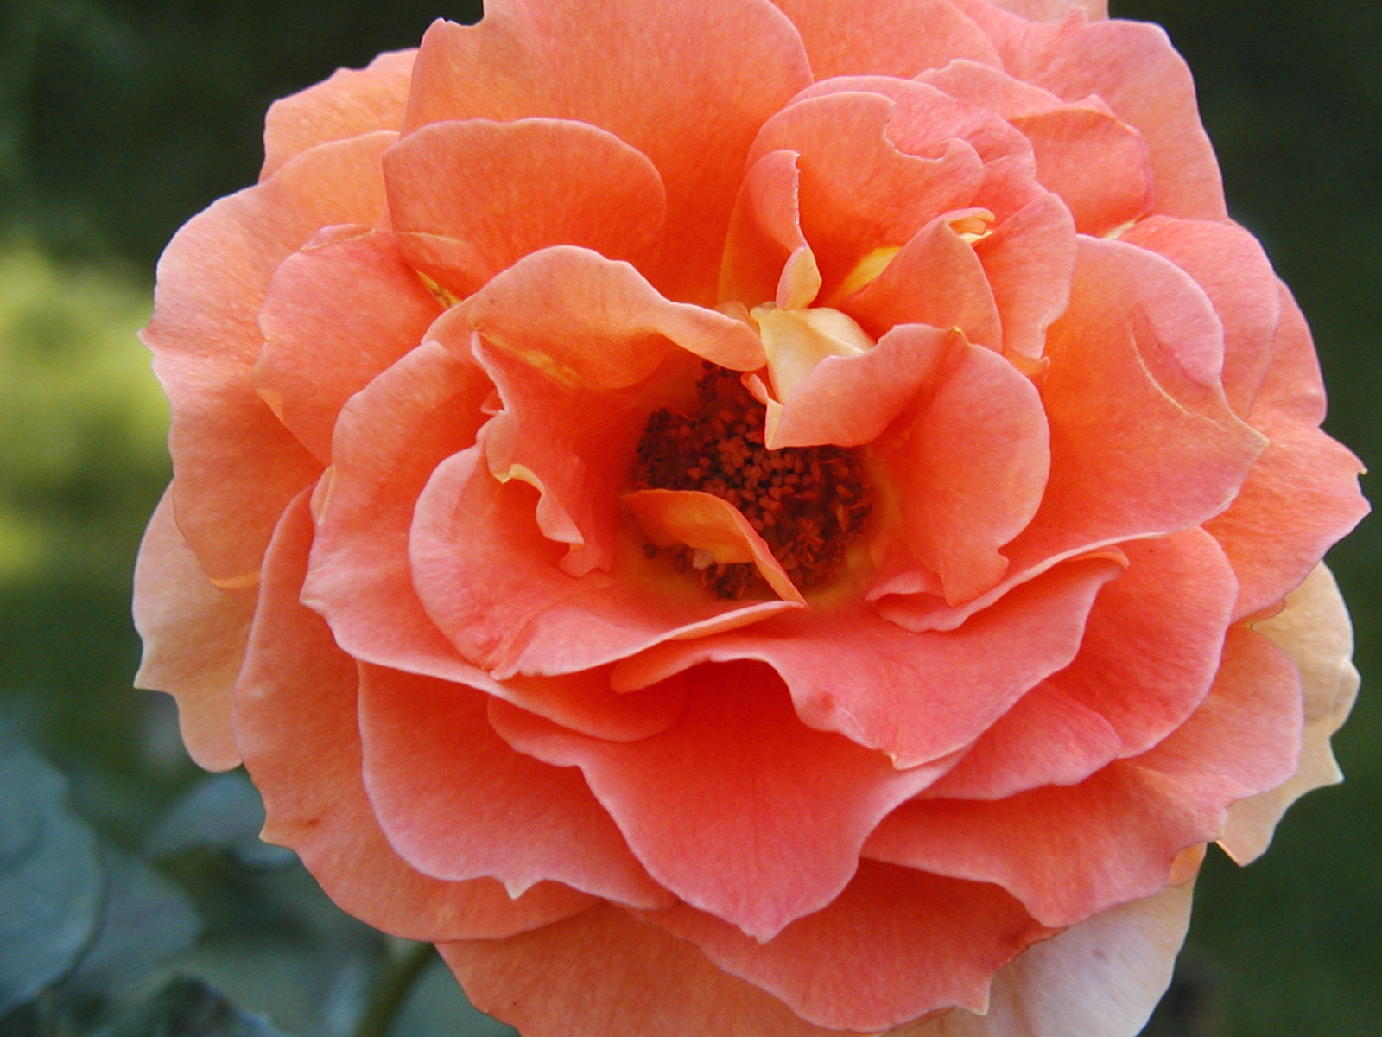
BBG
Brooklyn Botanical Garden
By Lena Mei, Savita Ramlall, and Edwin Gonzalez
Mentor: Dr. Gerry Moore
Co Mentor: Paul and Cathy

Slide 2
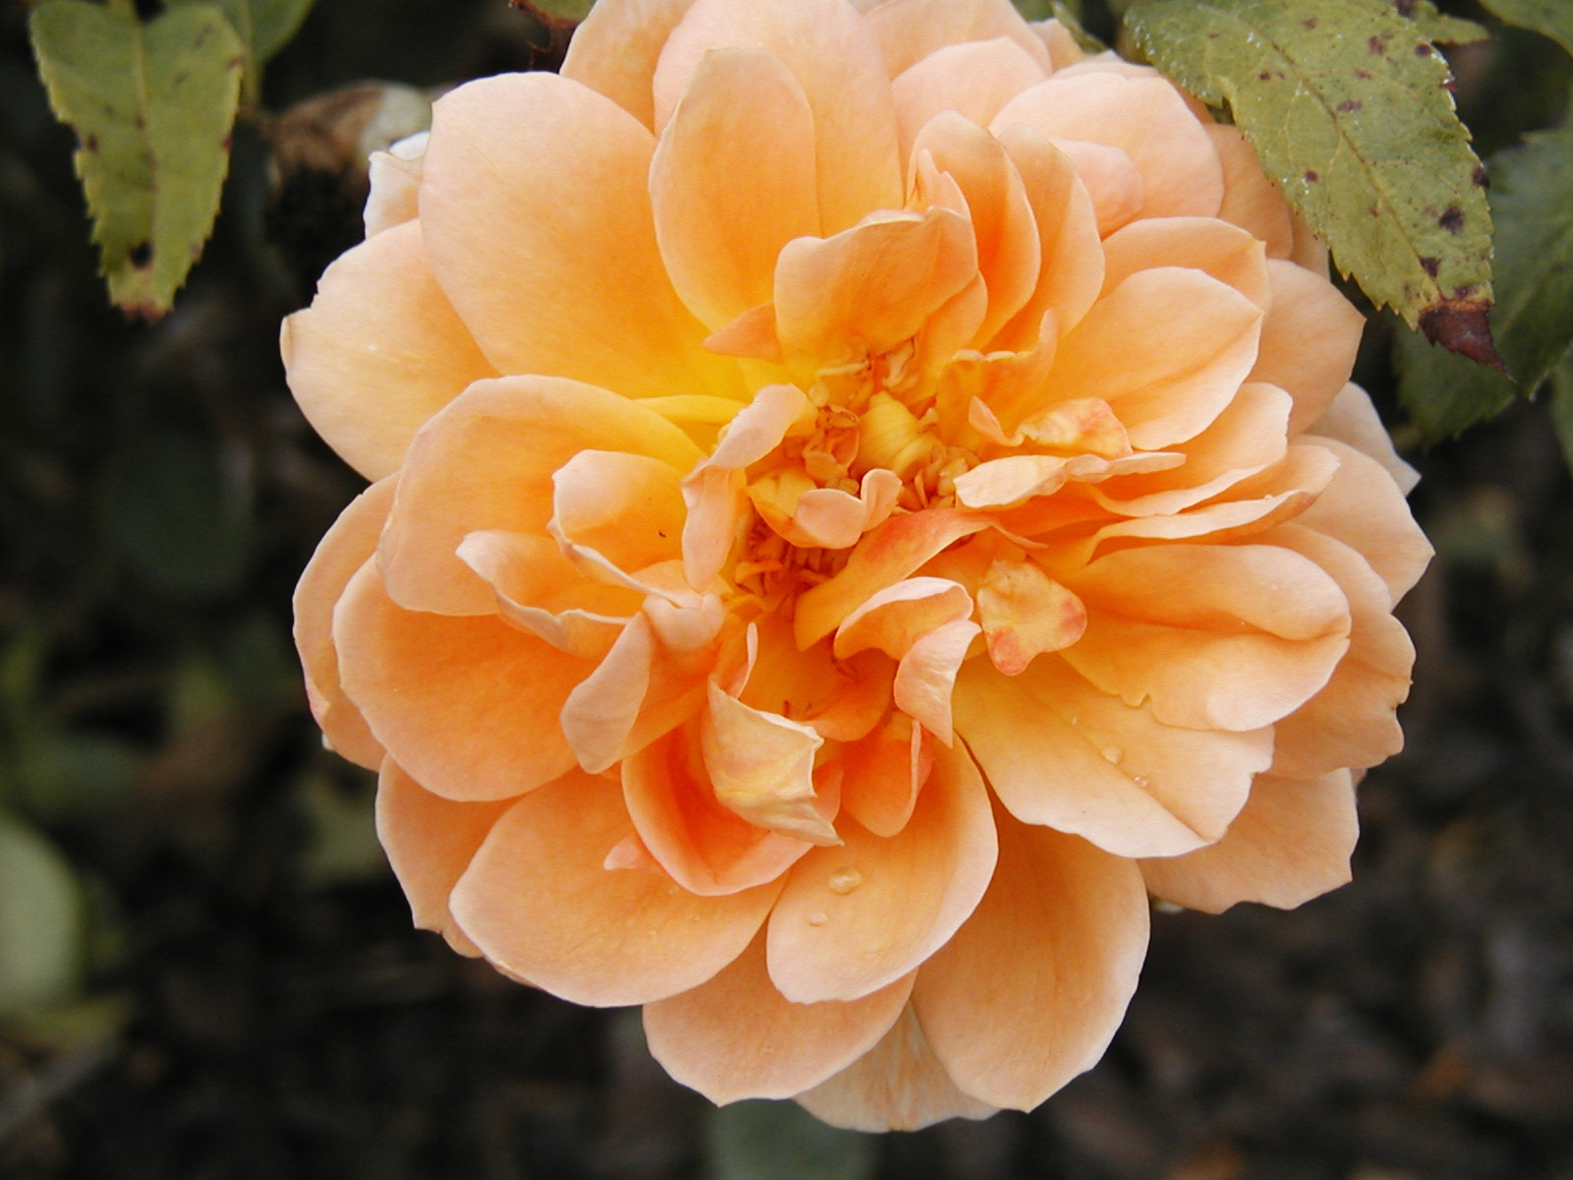
About The Garden
The Garden is 52 splendid acres founded in 1910.
This Garden features more than 10,000 kinds of plants from around the world.
As interns we use the garden as a reference. Where we photograph plants for the interactive keys.

Slide 3
Interactive Keys
Our main goal is to expand the work on the interactive keys.
What are the interactive keys?
The interactive keys is a computer program that helps identify and can also be used for synopsis of a classification of plants.
What we are adding to the interactive keys?
We are trying to add pictures to the interactive keys to show how the actual plant looks like. This will help researchers or people who are interested in plants identify their plants.

Slide 4
How to use the interactive keys
Get a copy of the Manual of Cultivated Trees and Shrubs by Alfred Redher .
Go to the full version of the Interactive Keys and click on each species description.
After you have the interactive keys downloaded you can use it to identify your plant
The interactive keys will have a list of questions you will answer about your plant and it will lead you to the species of plants that your plant is in.
After that there are more specific questions about the plant that will lead you to the actual plant name.

Slide 5

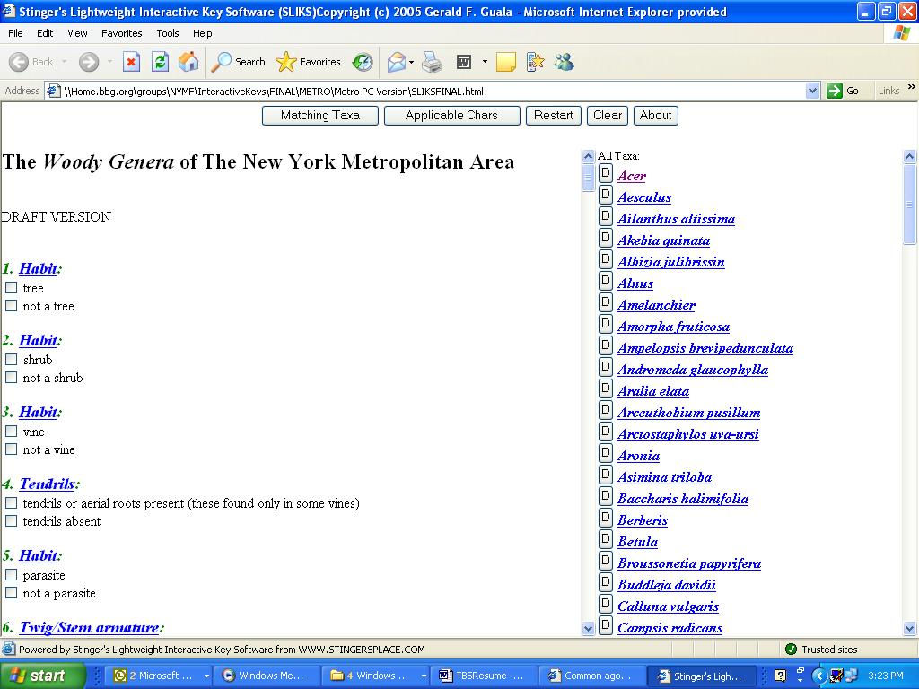
What Interactive keys are?
A computer program that process information to identify a certain plant.
For example:
The Woody Genera of The New York Metropolitan Area

Slide 6
Herbarium
Another part of our work is to work in the Herbarium.
What is a herbarium?
A herbarium is a cold room that has huge cabinets which preserves dried plant specimens from The New York Metropolitan area and plants from around the world.

Slide 7
Procedure
Collect specimen
Record data (locality, date, collector, etc.)
Dry it (preserves specimen)
Mount it on heavy paper (acids free)
Freeze it (kills insects, other pests)
Put in herbarium (storage)
Check specimens in herbarium periodically for insect damage and reorganization.
What we did for the project was mounting the specimens on the acid free archival paper.

Slide 8
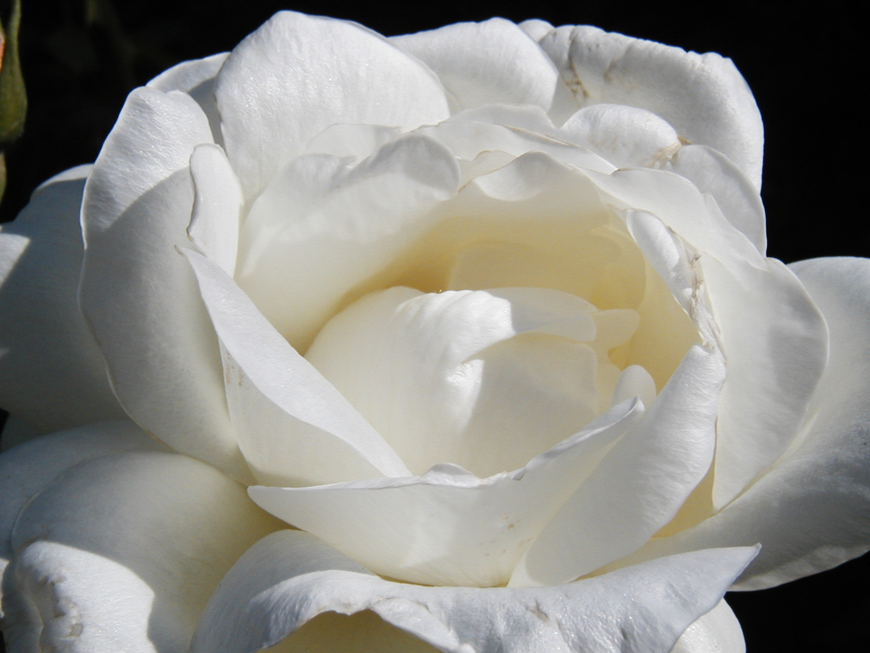
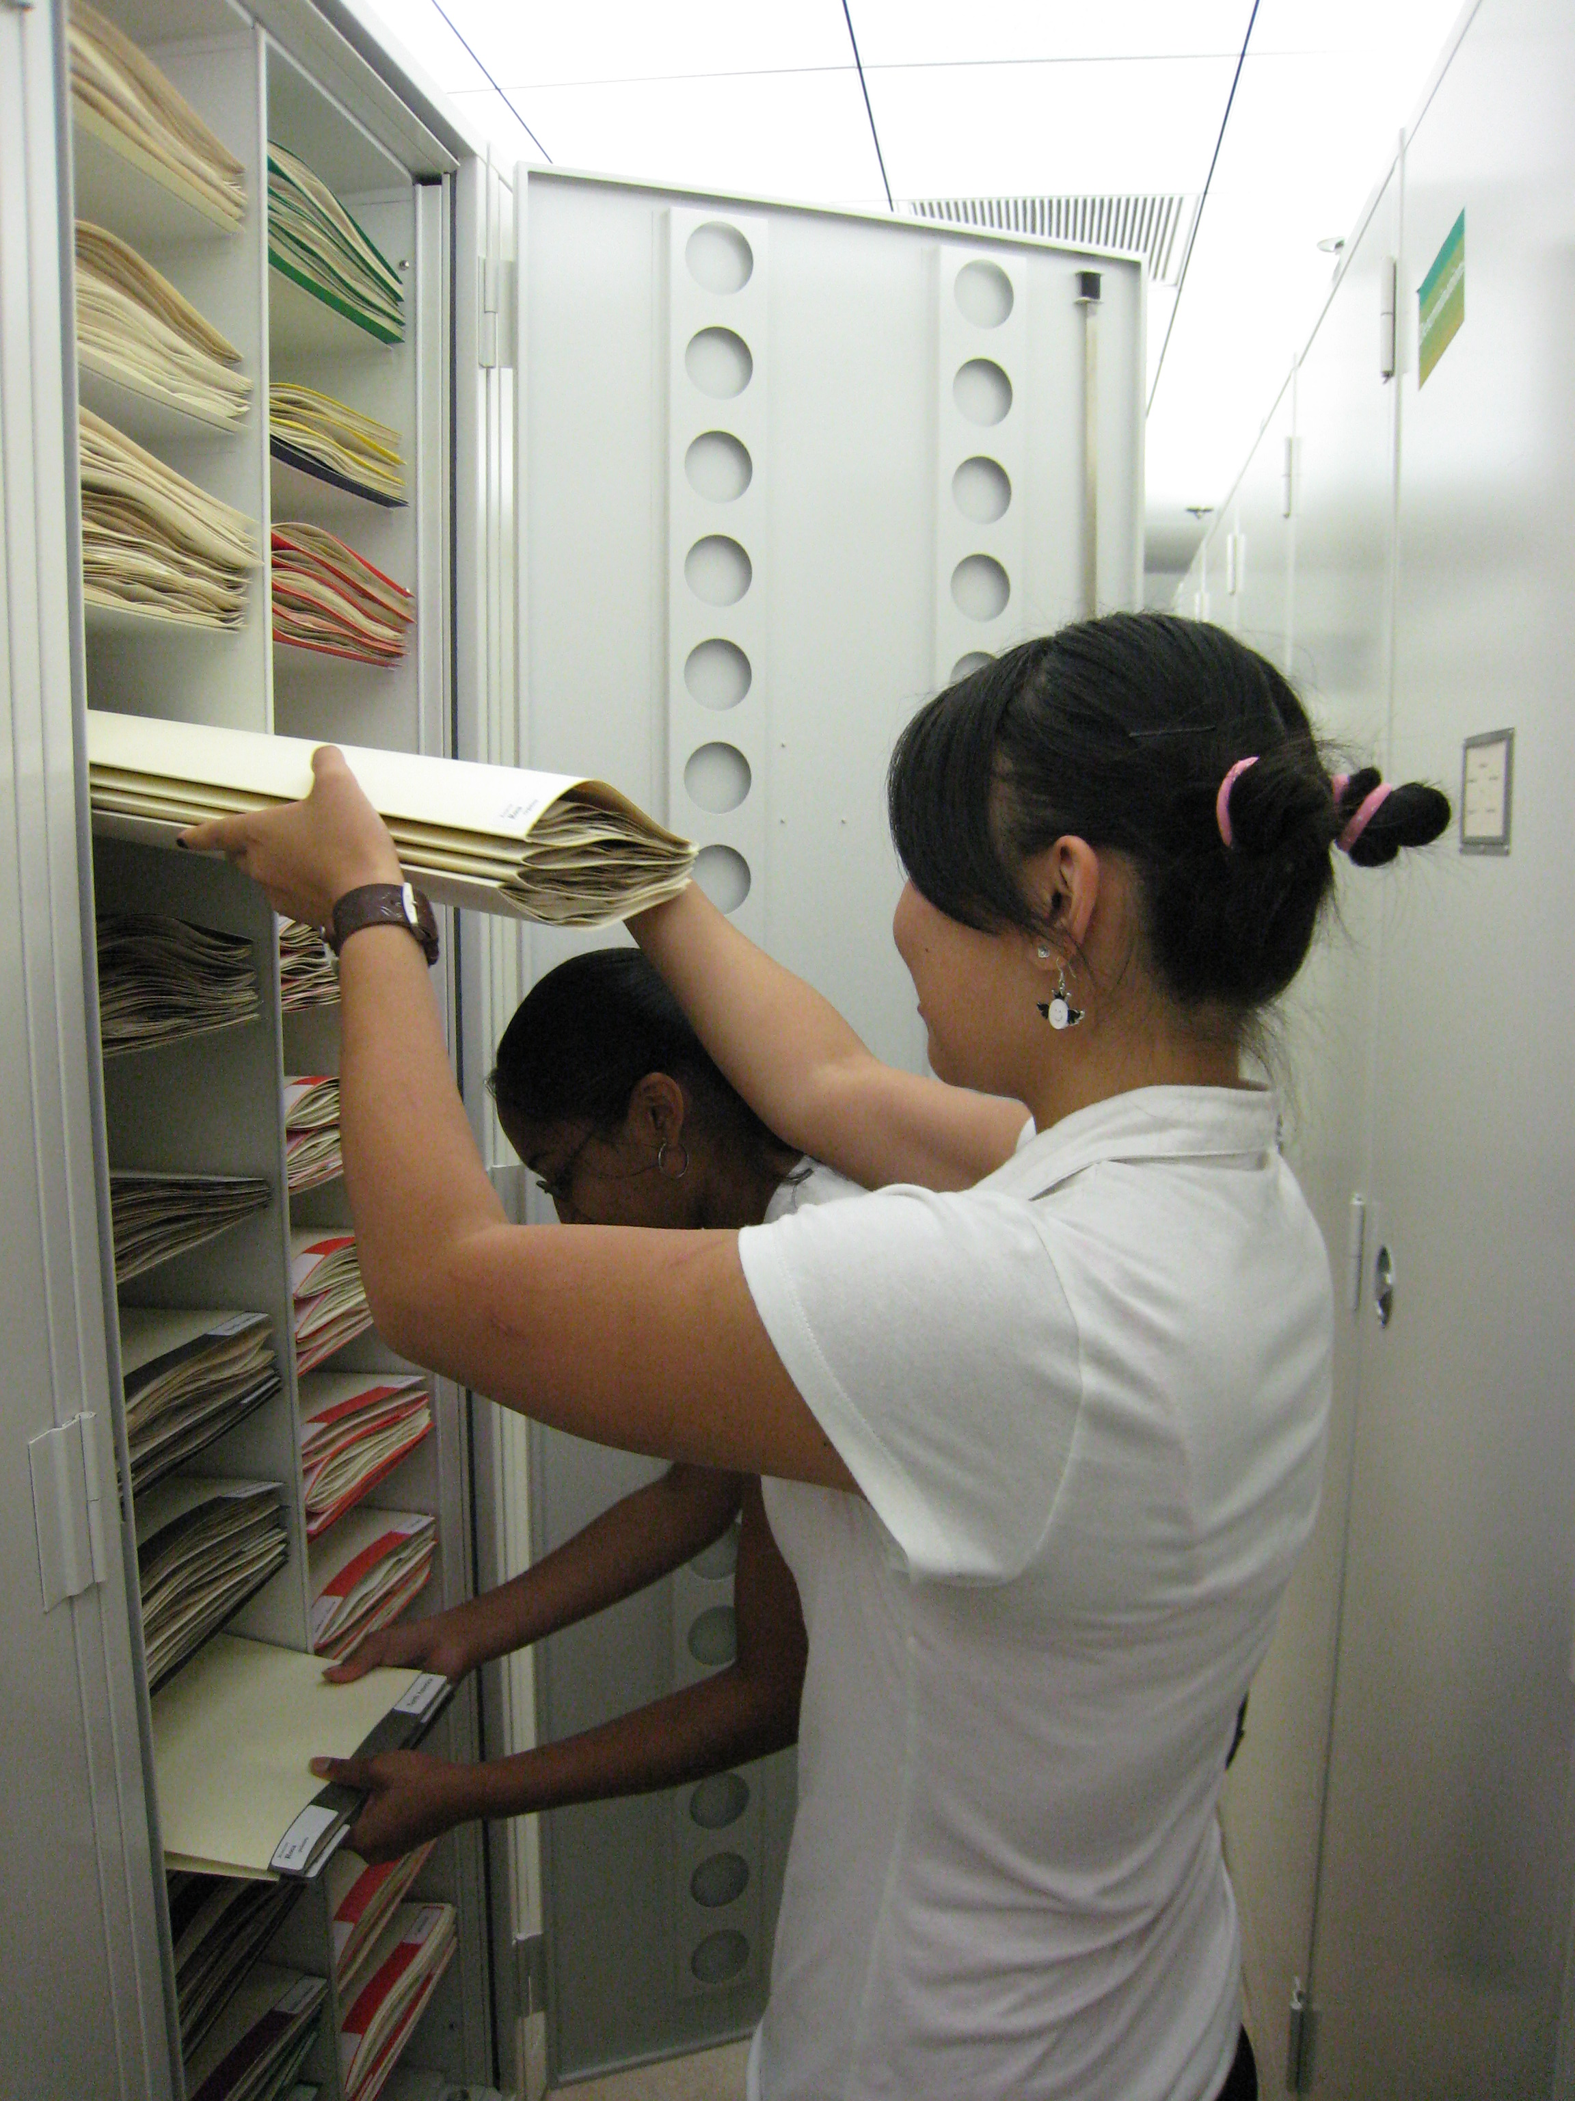
Purpose of a Herbarium
A herbarium is used to preserve plant specimens from hundred of years back to the modern day.
Specimens labeled with information about locations and dates collected.
Contains a wide range of species from around the world.
Edwin is behind the door. LMAO :P

Slide 9
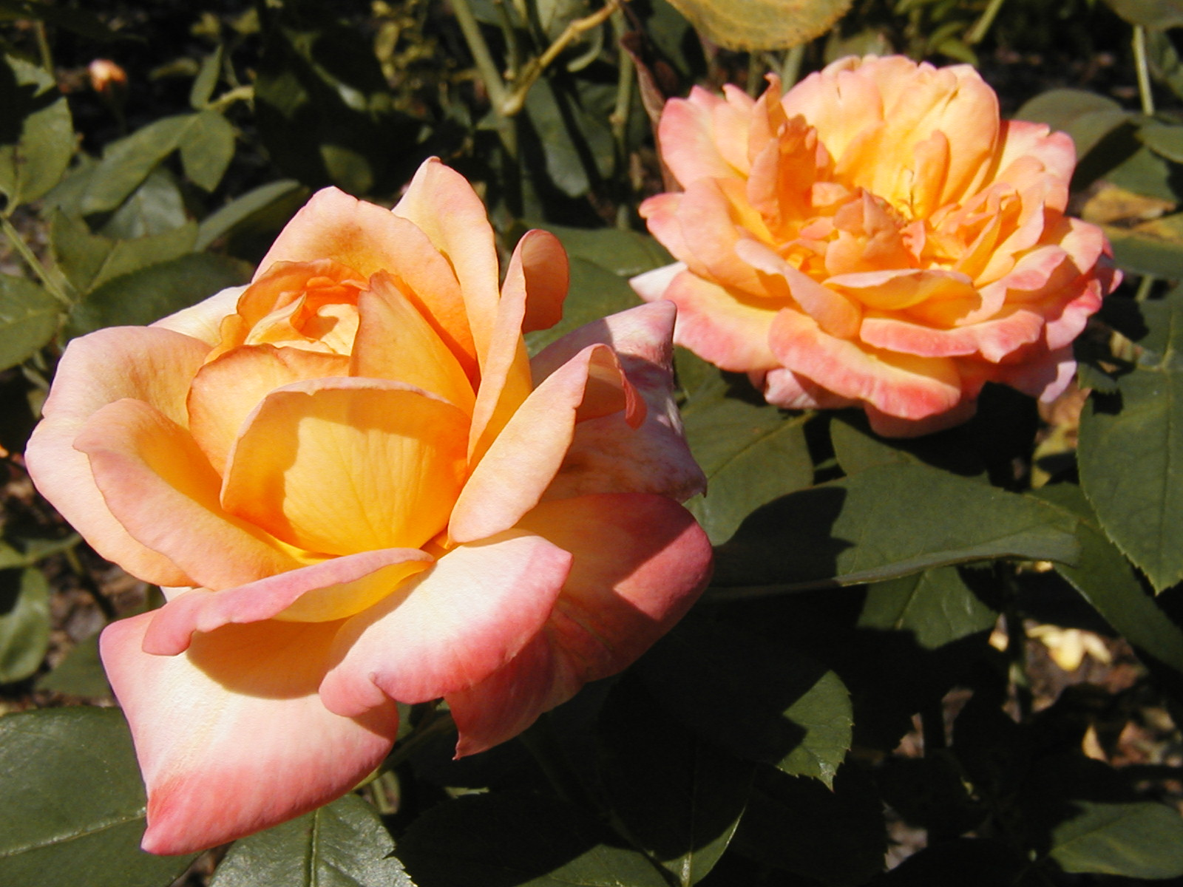
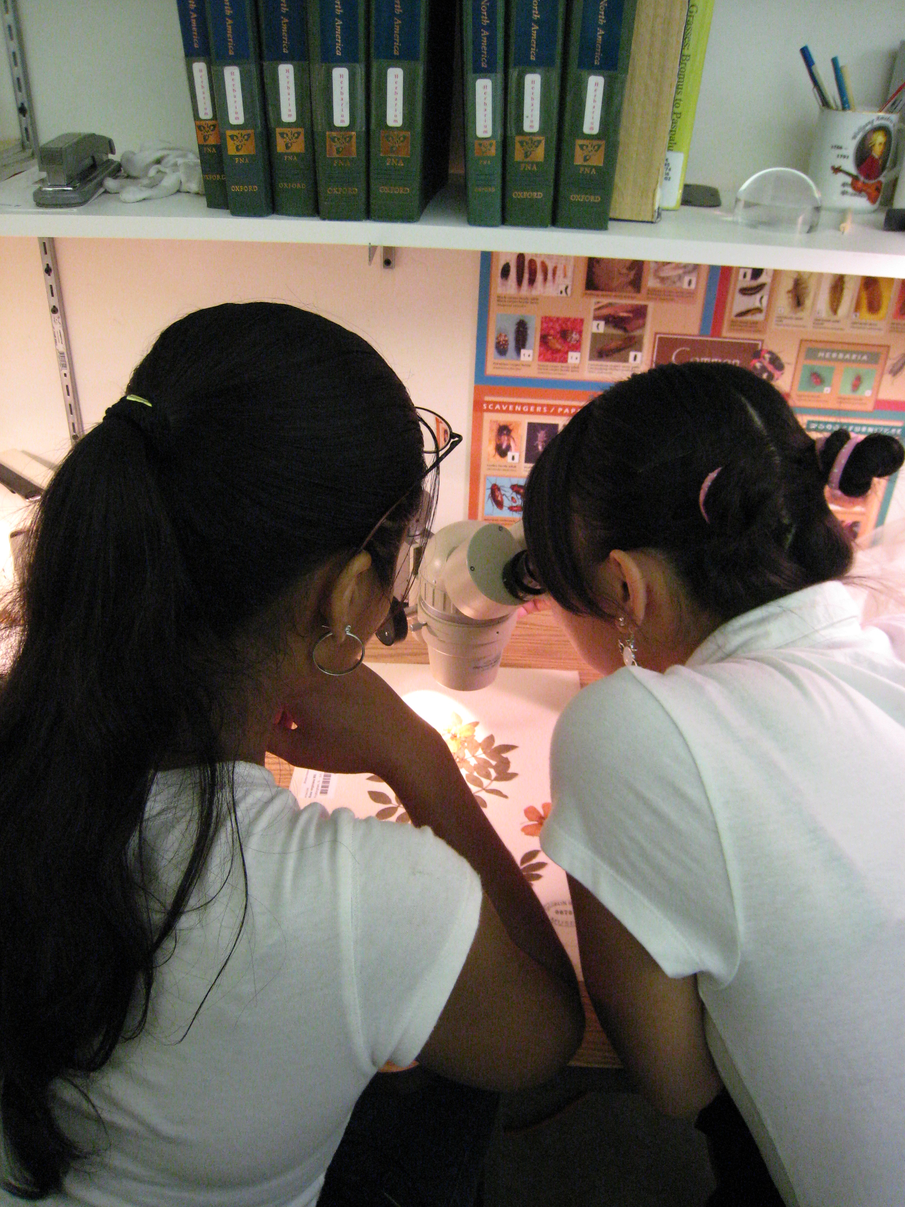
Importance of a Herbarium
Allow scientists to
1) preserve plants for 100s of years
2) study specimens throughout the world without traveling
3) study specimens collected during other time periods (e.g., 1700s, 1800s)
4) To allow researchers to extract DNA from old plants, to see how the species has evolved through time.

Slide 10
Seed Index
A less important project we worked on was trading seeds with other parts of the world.
Why?
To grow plants from other areas and research on the plants.
What we did…
  We had to package seeds to send to different botanical gardens around the world. Some times we ran out of seed to send.

Slide 11
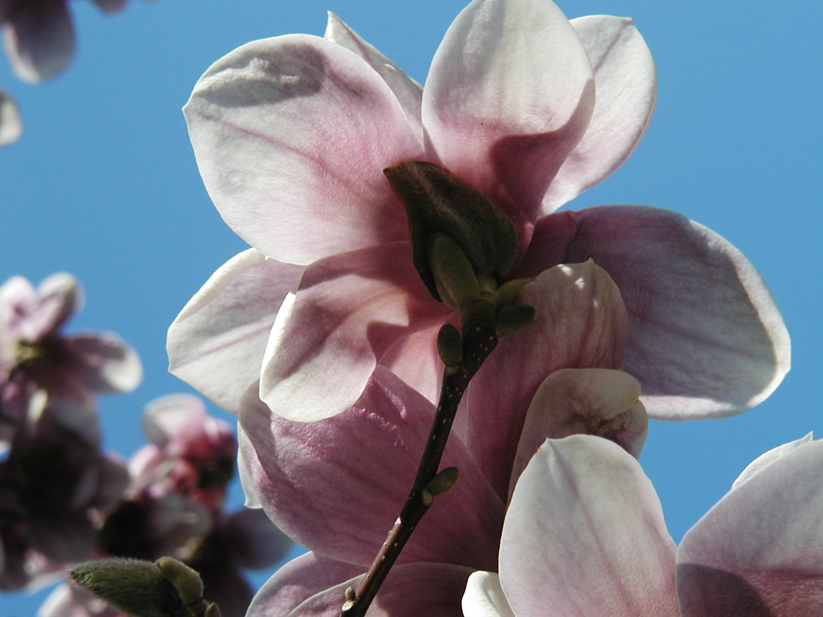
References
Bridson, D. and L. Forman. The Herbarium Handbook. Royal Botanic Gardens, Kew. 303 pp.
Holmgren, P. K., N. H. Holmgren, and L. C. Barnett. 1990. Index Herbariorum. New York Botanical Garden. 693 pp
Sheehan,Deniese, endangered plant species, August 30, 2006, August 30, 2006 http://www.dec.state.ny.us/website/dlf/privland/forprot/endspec/index.html
Rehder, Alfred (1940) Manual of Cultivated trees and Shrubs, New York The Macmillan Company

Slide 12

Acknowledgments
Dr. Gerry Moore
Paul & Cathy
BBG
Dr. Sat
HCS & Staff

Slide 13

THANK YOU!

